Slide 1

TGPEL Precision Engineering Limited
(A World Class Facility for precision toolings & plastic components)

Slide 2
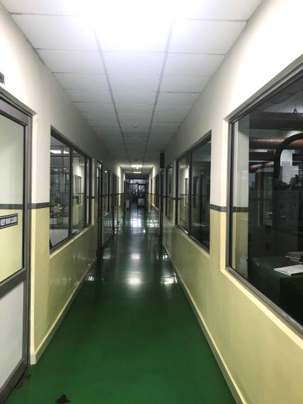
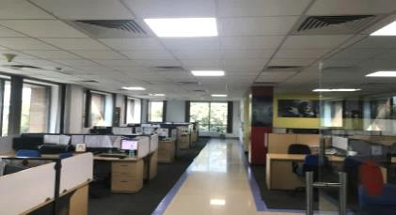
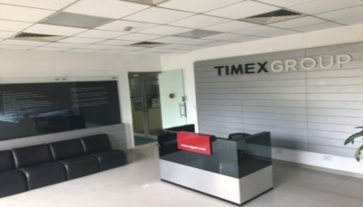
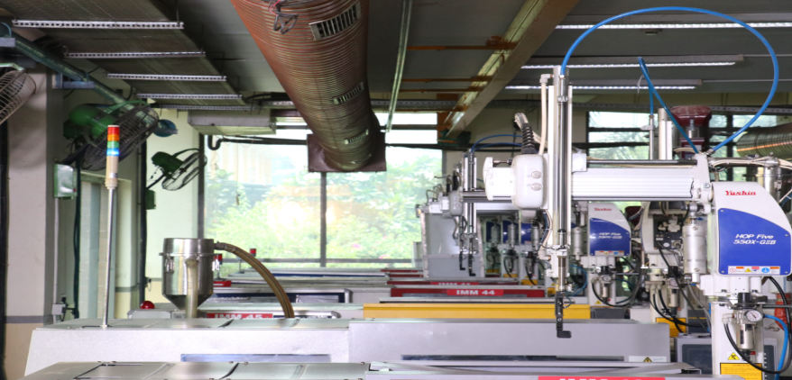
About Us.
Plant Location: NOIDA
No of Employees: 450
1988: Established Operation.
1998: Started commercial tooling and plastic component business.
2008: Hived off as TGPEL Precision
Engineering Limited.
2009: Operation shifted to new facility.
2019: Construction of 2nd Plant under progress (Commencement of operation from July 2019)
2020: Planning to set up 3rd plant in Gujarat

Slide 3
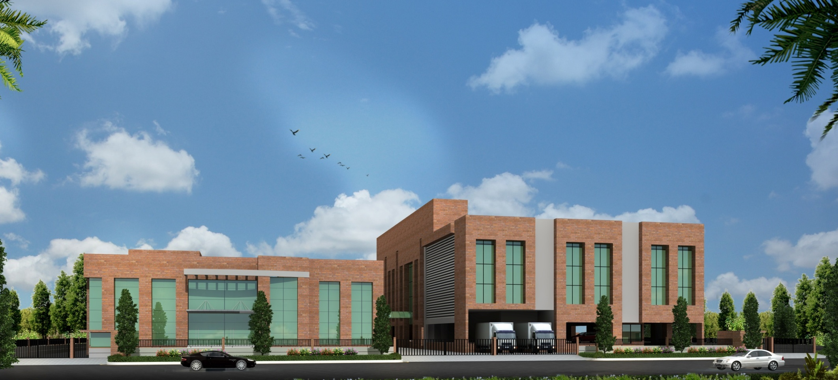
Upcoming Plant
PLANT - 1
PLANT - 2
Plant 2 Facilities
50+ injection moulding m/cs (50 – 660T) with assembly lines for integrated solutions to customers.
Vertical injection machines for insert and over moulded parts.
2K moulding for bi-colour and bi-material components.
Clean room facility for highly aesthetic and medical segments.
Plant 1:
State of the art CTR with 51 Injection moulding m/cs. (25 – 300T)

Slide 4
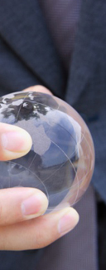
Vision & Quality Policy
Our Vision at TGPEL is to be among the best organizations in Precision Tooling and Plastic Component segments in India.
Quality Policy:
We at TGPEL believe in providing products of the highest quality to ensure loyalty and long term customer satisfaction.
TGPEL will continually improve its processes and systems by involving everyone in the organization and establishing quality objectives, taking into consideration customer requirements and future plans of the organization.
TGPEL will identify potential risks, evaluate the severity and take appropriate actions for risk mitigation to enhance business opportunity.
This policy shall be reviewed annually for its relevance and effectiveness to the changing needs of the customers and to satisfy applicable requirements.

Slide 5
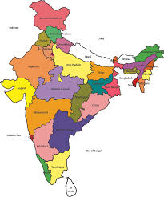
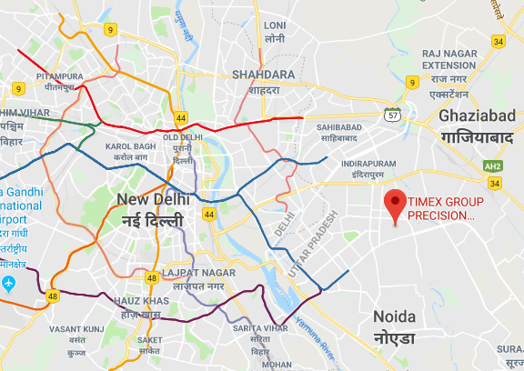
How to Reach Us
35 Km from International Airport, New Delhi.
26 Km from New Delhi Railway Station.
5 Km from Noida City Centre Metro Station.

Slide 6
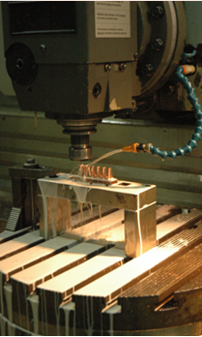
Overview
IATF 16949:2016 and ISO 9001:2015 Certified by TUV NORD.
Specializes in manufacturing of high precision injection moulds and production of injection molded components.
Qualified and experienced manpower from reputed institutes.
Internationally competitive products with respect to quality, cost, lead time and reliability.
Premium quality Tool steels, hardened through vacuum technology are used to enhance tool performance.
Critical machines installed in dust free and controlled environment.
Catering to Automotive, Electrical, Switchgear, Medical, Consumer Durables and FMCG segments in India and Abroad.

Slide 7
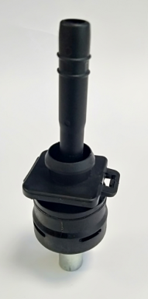
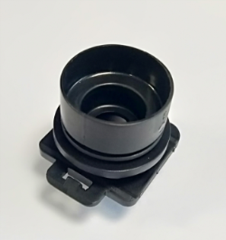
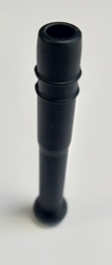
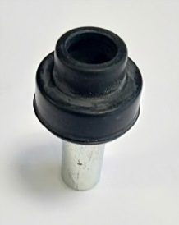
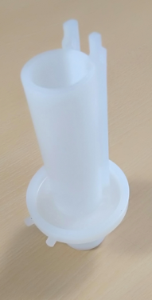
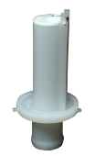
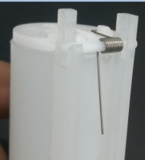
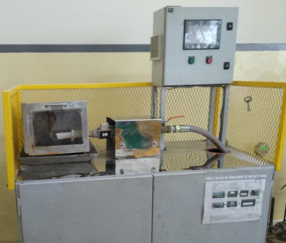
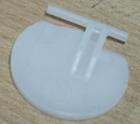

Offers Integrated Solutions
Reverse Engineering ---> Design ---> Prototypes ---> Series Moulds ---> Mass production ---> Child Part Development ---> Assembly ---> Testing as per Customer Requirement.
+
+
Casing Cap
Guide Pipe
Cap assy insert
Casing Cap Assembly
+
+
Pipe Inlet
Flapper
Spring
Pipe Inlet Assembly
Testing

Slide 8
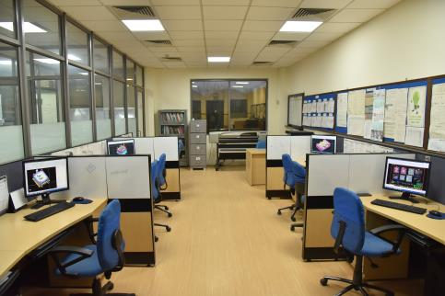
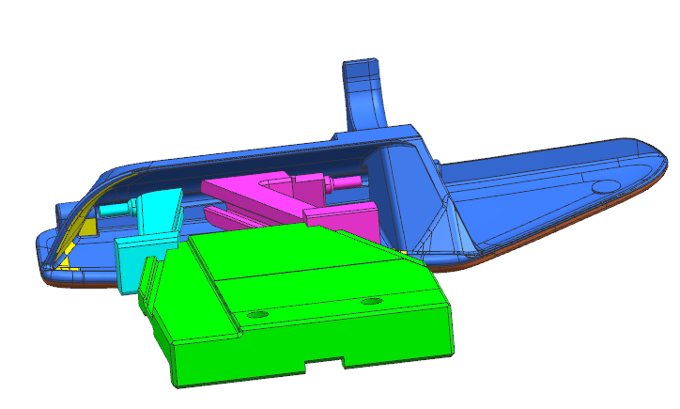
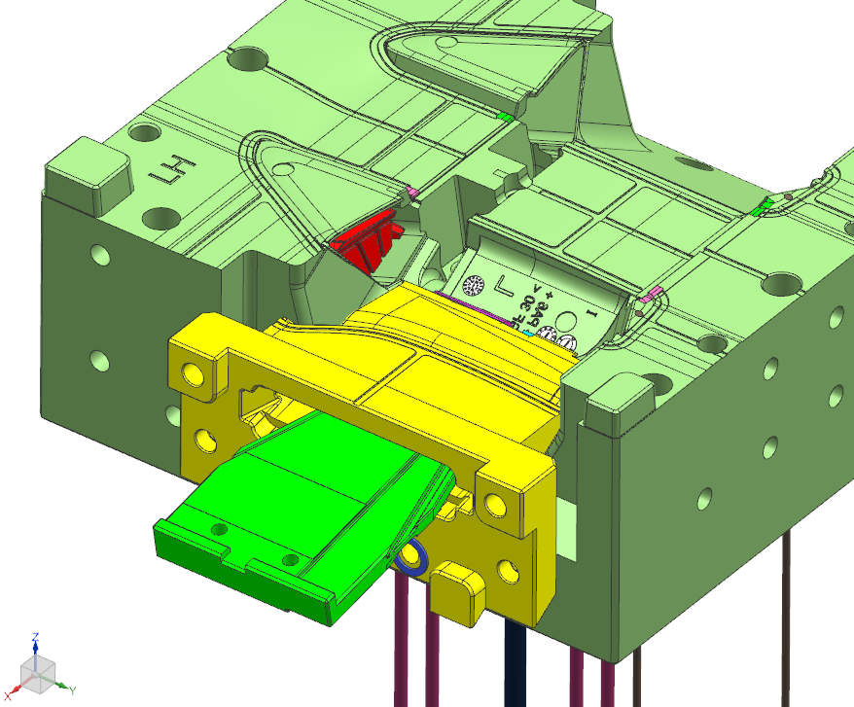
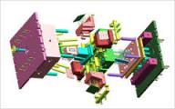
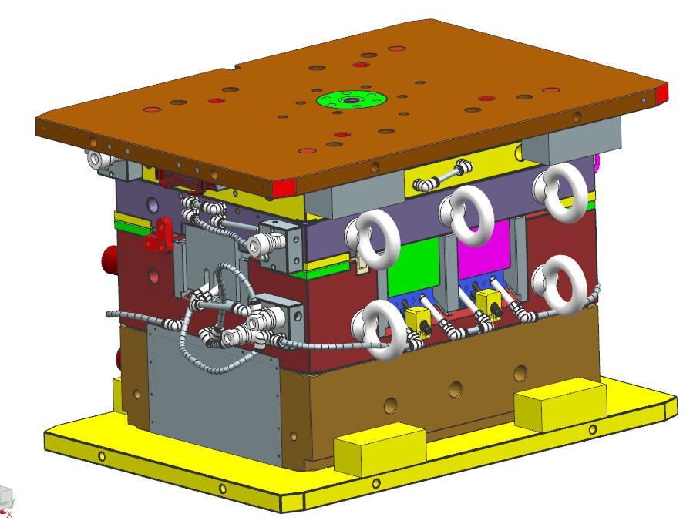
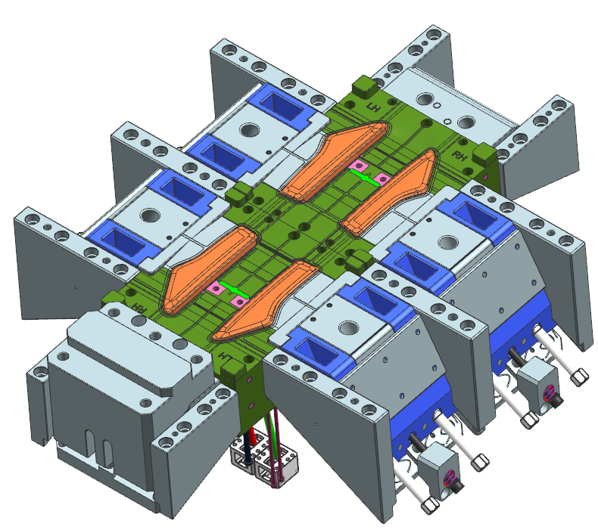
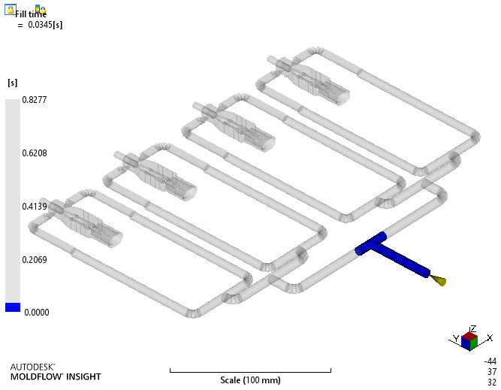
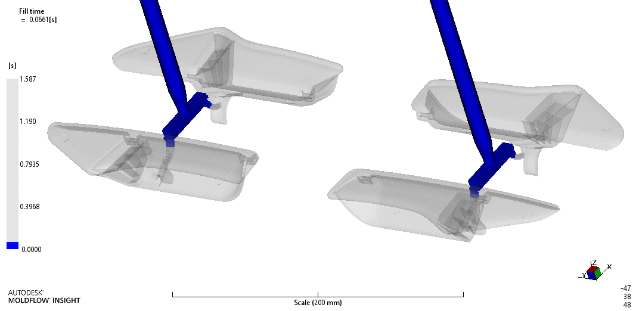
Design Capability
CAD/CAM: NX 11 (Formerly Unigraphics)
Multi station designer and manufacturing bundle with gateway, free form modeling, Solid modeling (3D CAD), 2D Exchange, Assembly, Translator and Mould wizard.
Reverse Engineering
Auto CAD
Colour printing facility up to A0 size
Mold Flow
Approved sources for mold flow on customer specific requirements.

Slide 9
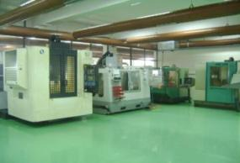
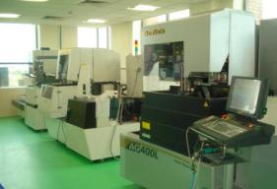
Tooling Facility
CNC Milling M/c
DMC 63 V ,Germany.
MAHO 630,Germany.
MAKINO,S-33,Singapore.
HASS,VF1 and Super Mini Mill,USA. Rpm Range-4000 to 15000 with Graphite milling facility.
Wire Cut M/c
FANUC ROBOCUT Alfa - 1iC,Japan (5axis submerged with AWF with CNC Control)
FANUC ROBOCUT Alfa - 0iD,Japan (5 axis submerged with AWF with CNC Control)
SODICK AG 400L, Japan

Slide 10
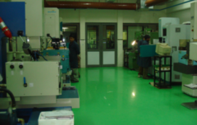
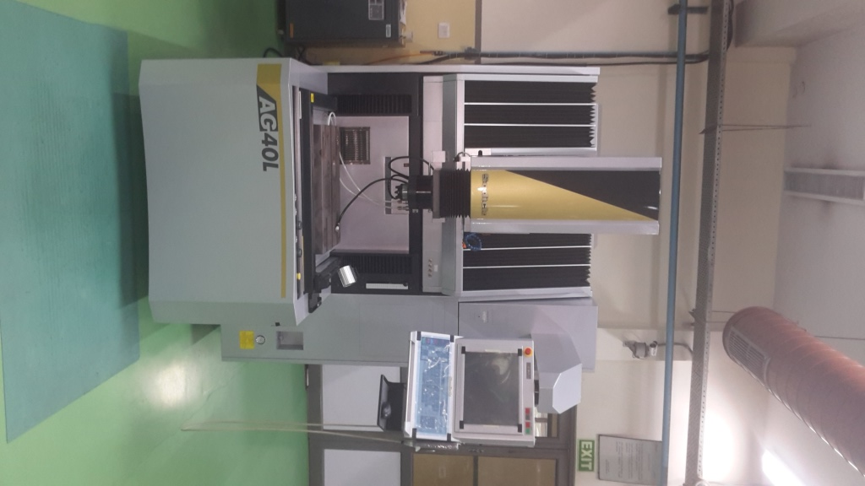
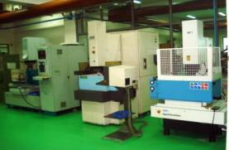
Tooling Facility
EDM M/c
AgieTron 1U CNC EDM.
With Orbiting Facility. Table size = 250mmx160mm
Agie 1p EDM.
Table size = 300mmx200mm
Agie Charmilles 1P
Table size = 400mmx300mmx200mm
Chmer 434C CNC Edm.
Table size = 400mmx300mm
Electronica Smart / Leader ZNC EDM.
Table size = 300mmx200mm
Sodick AG 40L, Japan.
4 Axis EDM with 20 rpm C axis rotation Facility.
Surface finish: 2.6 μm Rz
Table size = 600mmx400mm

Slide 11
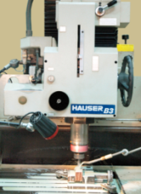
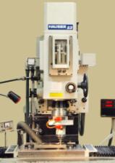
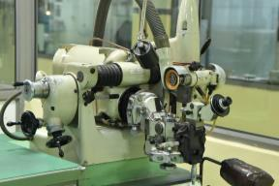
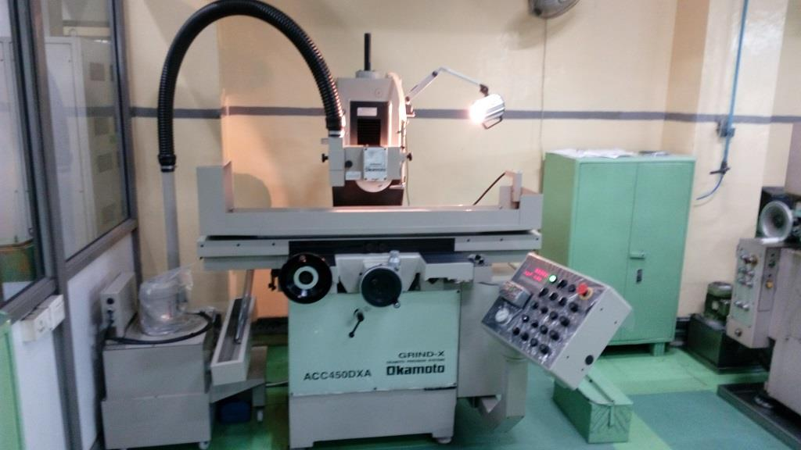
Tooling Facility
HAUSER, Switzerland.
Up to 80000 rpm. 1.0 micron accuracy. Inside taper grinding facility up to 5 degree.
HAUSER, Switzerland.
3 axis machine. Can drill holes up to 0.3mm diameter. Cutters as small as 50 micron dia can be used.
Jig Grinding M/c
Jig Boring M/c
Universal Grinding M/c
Surface Grinding M/c
EWAG-WS11, Switzerland
Cutters/Pins up to 0.2mm diameter and with an accuracy of 1.0 micron can be ground
Okamoto -ACC 450DXA, Japan
High precision surface grinder with auto feed facility with an accuracy of 0.1 micron

Slide 12
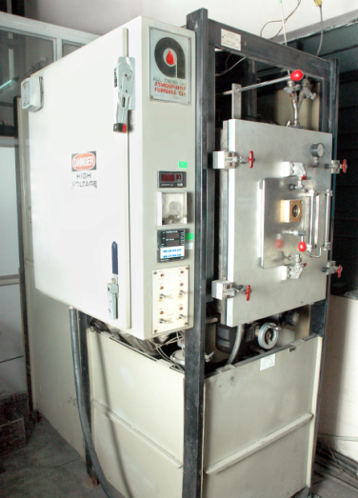
Tooling Facility
VACUUM HARDENING-
ATMOSPHERE FURNACE CO. USA.
Specification :-
Max temperature. 1316°C.
Muffle size: 200x200x400 mm
Heat treatment can be done without
distortion. Mould life increases due
to fine grain structure.
INERT GAS HARDENING-
SOLO, SWITZERLAND.
Specification :-
Max. Temperature: 1150°C.
Muffle size: 300x200x150 mm.
Inert gas: cracked ammonia.
Facility for oil quenching.
Hardening Furnace

Slide 13
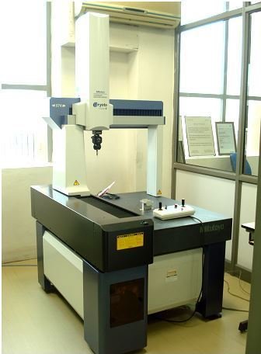
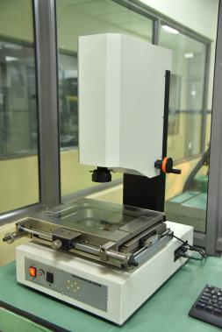
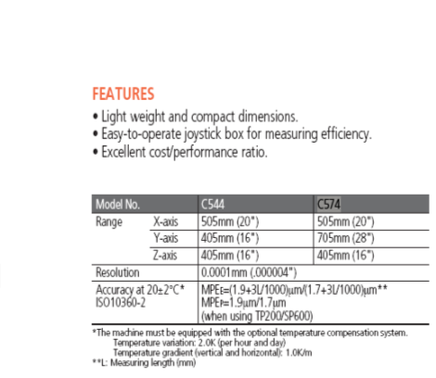


Inspection Facility
Coordinate Measuring Machine - CMM
Video Measuring Machine - VMM
Mitutoyo, Japan
Light weight and compact dimensions.
Easy to operate joystick box for measuring efficiency
Excellent cost/performance ratio
Resolution: 0.0001mm
Scanner attachment for reverse engineering

Slide 14
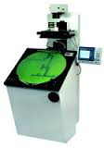
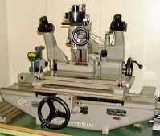
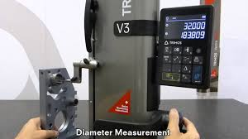
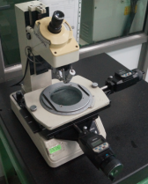
Inspection Facility
Universal Measuring M/c
SIP, MU-214B, Switzerland.
Profile Projector
BATY, SM24, U.K.
with 10X,50X,100X magnification.
Height Master
Tool Maker’s Microscope
Mitutoyo, Japan.
TRIMOS V-3, Switzerland.
Range:0-600mm.
Other Supporting Instruments

Slide 15
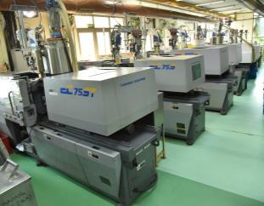
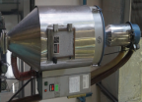
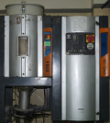
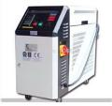

Injection Moulding Facility
Microprocessor controlled closed loop Injection Molding Machines (Arburg, L&T and Ferromatic Milacron) with Bimetallic Barrels and Screws to process engineering plastic materials.
Installed FANUC and Toshiba All Electric Machines for production of high precision parts.
Injection Moulding M/c
Machines are attached with pre-heaters to eliminate the moisture content for better part quality
Dehumidifiers are available to meet the specific standards for processing engineering materials
Pre-Heaters
De-Humidifier
MTC
Equipped with Mould temperature controllers to maintain mould temperature.
HRTC
Multipoint hot runner temperature controllers are available to process hot runner moulds

Slide 16
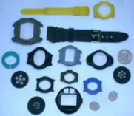
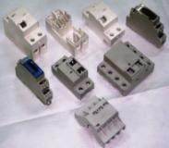
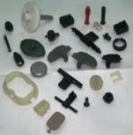








Moulding Capability
Specializes in production of high precision injection molded parts.
Expertise in running hot runner, semi hot runner, hot Sprue and auto unscrewing moulds.
Uninterrupted power supply backed by 3 DG sets (500KVA – 2 nos & 750KVA – 1 no) and UPS (80KVA , 120KVA, 400 KVA and 200 KVA). All critical machines including molding are supported by UPS.

Slide 17
Material Processed
Poly Carbonate 10% - 30% GF
  PC943
  PC143
  PC121
  PC123
  PC 141R
Poly Amide 10% - 50% GF
  PA 6
  PA66
  PA46
  PA 11
Polyoxymethylene (POM)
  Delrin 500 P
  Delrin 900 P
  Delrin 100 P
4. Polypropylene
  PP talc filled
  PP FR
5. Acrylonitrile butadiene styrene
  ABS 380
  ABS DOW
6. Poly phenylene sulfide (PPS)
  RYTON
  FORTRON
Poly Styrene (PS)
  HIPS
  SAN
8. PC-ABS
  Cycoloy
Polybutylene terephthalate
  Arnite TV4 240
  Arnite TV4 4260
Poly Ethersulphone (PES)
Poly phenylene oxide (PPO)
Poly Vinyl Chloride (PVC)
Poly Urethane (PU)
  Santoprene
  TPU
Polyvinylidene fluoride (PVDF)
Poly methyl methacrylate (PMMA)

Slide 18
Exports Footprints
Developed moulds of Energy Meter Components for Socomec-France and exported components for 10 years since 2005.
Moulds exported to Socomec-France.
Moulds exported to Timex, USA.
Moulds exported to Schneider-Finland, Schneider-Spain, Schneider-Denmark, Schneider-China & Schneider-France.
Moulds for GM exported to NYX, USA.
Moulds exported to BRB cables, Bangladesh.

Slide 19
Competitive advantage
TGPEL provides one stop shop solution for mould development, part manufacturing, sub-assembly and complete product assemblies to its esteemed customers.
MSIL – VSA approved Green Supplier.
Organization structure capable of handling multi-locational facilities.
Experienced Designers and CAM engineers.
Qualified tool makers and CNC operators.
In-house Mould Trial and Moulding facility.
Effective preventive maintenance system for machines and moulds.
In-house heat treatment facility.
In-house inspection facility up to 1 micron.
Capable to develop and process fully automated moulds.
Capable to develop and process multi cavity moulds with low cycle time and dimensional accuracy.
Capable to process all kinds of engineering plastics and parts having mirror finish.

Slide 20



































Esteemed Customers

Slide 21



Injection Moulds

Slide 22













Electrical Parts
P/N: Terminal Block : RM: PC GF 10
P/N: Coil Frame : RM: PC
P/N: Terminal Block : RM: PBT / PA GF
P/N: Terminal Block : RM: PBT GF
P/N: Base, Terminal Block, Terminal Cover, Display: RM: PC ABS
P/N: Housing: RM: PC GF 10
P/N: Bobbin: RM: PA
P/N: Frames: RM: PC ABS
P/N: Holder: RM: ABS / PC

Slide 23







Industrial Parts
P/N: Gears: RM: POM
P/N: Water Meter Parts: RM: PC./ PC ABS
P/N: Flange: RM: POM
P/N: Canister Bracket: RM: PA 66 GF 50
P/N: Flange: RM: PA 66 GF 50
P/N: Moto coupler / Housing: RM: PA 66 GF 30

Slide 24











Automotive Parts
P/N: Flange : RM: POM
P/N: Manifold : RM: PA 6 GF30
P/N: Cover : RM: PP
P/N: Protector : RM: PP
P/N: Air Vent : RM: PC ABS
P/N: Bobbin: RM: PPS GF 40
P/N: Locating Pin Cover: RM: PP
P/N: `Speaker Grill : RM: PP

Slide 25














Automotive Parts
P/N: Garnish : RM: PC ABS / PP
P/N: Fuse Box Cover : RM: PP
P/N: Door Handle : RM: PA 6 GF
P/N: Housing : RM: PA 6 GF 30
P/N: Bobbin : RM: PPS GF40
P/N: Alternator Cover : RM: PA 66 GF 30 FR
P/N: CDI Case : RM: PBT GF 30
P/N: Door RR Handle : RM: PA 6 GF

Slide 26





















Automotive Parts
P/N: Bobbins : RM: PA6/66 GF 30
P/N: Encapsulations : RM: PA 6 GF
P/N: CRB Housing : RM: PA66 GF 35
P/N: Door Handle : RM: PA6/66 GF 30
P/N: Clamp RM: PP
P/N: Wheel Speed Sensors RM: PA 6/66 GF 30
P/N: WSS Connector: RM: PA6/66 GF 30
P/N: Hook: RM: PA
P/N: Clamp: RM: POM

Slide 27



















Automotive Parts
P/N: Housing : RM: PC ABS
P/N: Bobbin : RM: PA6/66 GF
P/N: Clamps : RM: POM
P/N: Rod : RM: PA6/66 GF 30
P/N: USB Cover : RM: PC ABS
P/N: Clamp: RM: PP / PA
P/N: : RM: PPS GF 40 / PA 6
P/N: Cover : RM: PA6/66 GF 30
P/N: Bobbin / Housing : RM: PA6/66 GF 30
P/N: Antenna: RM: ASA / TPU

Slide 28












Automotive Parts
P/N: Stay : RM: PA6 GF
P/N: Mirror Housing ORVM : RM: POM / PP
P/N: Clamp : RM: PP
P/N: Wiper Gear : RM: POM
P/N: Holders : RM: PBT GF 30
P/N: Holders : RM: PBT GF 30
P/N: Roof Rail : RM: PC+PBT GF
P/N: Housing IRVM: RM: PP
P/N: Canister: RM: PA66

Slide 29














Automotive Parts
P/N: Magnetic Holder : RM: PPS GF 40
P/N: Clip : RM: PA
P/N: Seal Plate : RM: PA
P/N: Housing : RM: PA 6 GF 30
P/N: Holder : RM: POM
P/N: Cap Handle : RM: PA 6
P/N: Bobbin : RM: PA 6
P/N: Housing with Clip : RM: PA 6
P/N: Casing Cap Assy : RM: PA 6 GF
P/N: Cable tie: RM: PA 6
P/N: Pipe inlet Assy: RM: HDPE

Slide 30














Medical Parts

Slide 31
Our Contacts.
TGPEL Precision Engineering Limited
A-27, Sector – 68, Noida- 201307, Uttar Pradesh, INDIA
Ph: +91-120-5004205, 06
Email: enquiry_ped@timex.com
Website: www.tgpel.com

Slide 32

THANK YOU !..
(We look forward to your valuable business association)

